Slide 1

Azure Basics
Most Essential

Slide 2
Context:
Azure Introduction :: 3-7
Azure Subscription :: 8
Azure Active Directory : 10-11
Azure Resources Group : 9
Azure Storage Account : 12-22
Azure SQL Database : 23-29
Azure Key Vault : 30
DataBricks : 31-33

Slide 3
Azure Introduction:
Azure is the Cloud Platform developed by the Microsoft . It provides a broad range of cloud services, including compute, analytics, storage and networking. Users can pick and choose from these services to develop and scale new applications or run existing applications in the public cloud.
Azure offers four different forms of cloud computing: infrastructure as a service (IaaS), platform as a service (PaaS), software as a service (SaaS) and serverless functions
Microsoft charges for Azure on a pay-as-you-go (PAYG) basis, meaning subscribers receive a bill each month that only charges them for the specific resources and services they have used.
We can also create Azure Free Trail which will come with 15,000 credits and one month validity
Useful Link : https://www.techtarget.com/searchcloudcomputing/definition/Windows-Azure

Slide 4
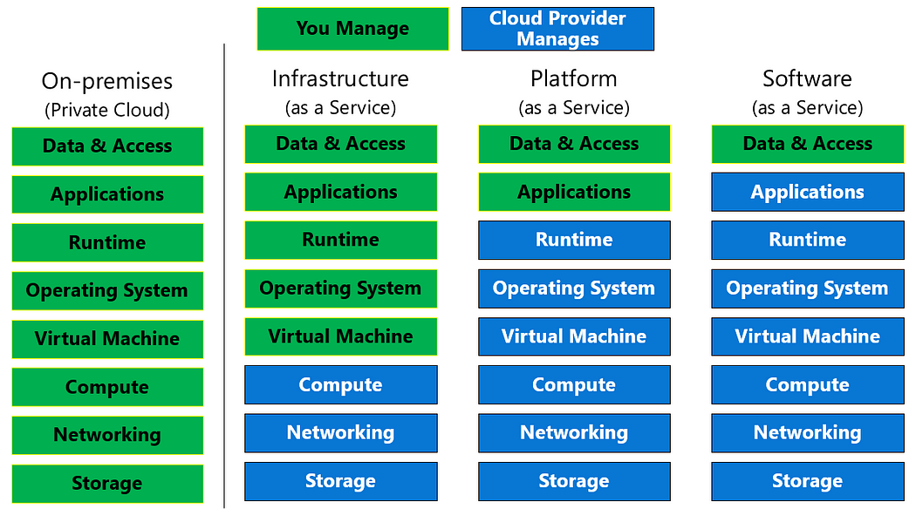
::Different Cloud Computing ::

Slide 5
Infrastructure as a Service (Iaas):
As you can see in the above image , Iaas is one of the cloud computing service
Azure Infrastructure as a Service (IaaS) is like a virtual toolbox for your business's IT requirements. It equips you with all necessary hardware and tools, such as servers, network connections, and IP addresses, without the need for ownership or maintenance. Everything is readily available in the Azure cloud, prepared for use whenever required.
One of the key advantages of Azure IaaS is its cost-effectiveness. Instead of making hefty investments in infrastructure and incurring ongoing costs, businesses can leverage Azure IaaS to pay solely for what they utilize. During periods of low demand, money is not wasted on unused resources. Conversely, during high-demand periods, Azure IaaS ensures that you can meet demand without straining your budget
Useful link : https://azure.microsoft.com/en-us/resources/cloud-computing-dictionary/what-is-iaas

Slide 6
::Platform as a Service (Paas)::
As you can see in the image above, a PaaS solution requires less user management and does not provide access to the operating system. That means that the PaaS is a complete development and deployment environment in the cloud and provides a framework that developers can build upon to develop or customize cloud-based applications.
For example, the Azure Web Apps service provides an environment for you to host your web applications, but you don't have to access the virtual machine and the operating system. And Azure SQL Database is a fully managed platform as a service (PaaS) database engine that handles most of the database management functions such as upgrading, patching, backups, and monitoring without user involvement.
PaaS is designed to make it easier for developers to quickly create web or mobile apps, without worrying about setting up or managing the underlying infrastructure of servers, storage, network, and databases needed for development.
Useful link : https://azure.microsoft.com/en-us/resources/cloud-computing-dictionary/what-is-paas/

Slide 7
::Software as Service (SaaS)::
A SaaS requires a least management, Microsoft is responsible for managing everything you just need you just use the software
SaaS Allows you to connect to cloud-based apps using internet , A greater example is Outlook, Office365 etc.,
Useful link: https://azure.microsoft.com/en-us/resources/cloud-computing-dictionary/what-is-saas/

Slide 8
::Azure Subscription::
To use Azure's cloud-based services, you must first purchase a subscription. It acts as a single billing unit for Azure resources, with subscriptions billed for services used in Azure.
Basically, three types of Azure Subscriptions are available those are Free, Pay-as-go, Member or enterprise subscriptions
Free, pay-as-you-go, and member offers are the three primary types of subscriptions accessible. The free account is a subscription that gives you unrestricted access to Azure resources as well as a $200 credit toward paid products.
Until and unless we upgrade our subscription to the paid one , all the resources and the services that we have created during this period will automatically be disabled at the end of the of the free trial period.
If you’re a Visual Studio subscriber, you get Azure credits every month that you can use to explore and try Azure services. When you activate your credits, you’ll create a new Azure subscription, where you can start using them right away. No credit card is required.
The amount of Azure credits that you receive depends on the type of Visual Studio subscription you have. When you reach the monthly cap for your credits, your Azure services will stop until your next monthly credits are added unless you choose to remove the spending cap by upgrading to pay-as-you-go pricing.

Slide 9
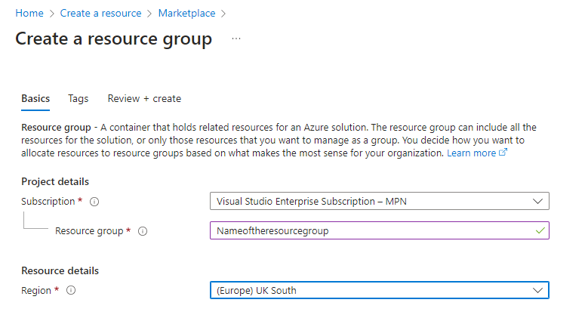

::Azure Resource Group::
Azure resource group, its heart in azure and plays very key role.
A resource group is a container that holds related resources for an Azure solution. The resource group can include all the resources for the solution, or only those resources that you want to manage as a group. You decide how you want to allocate resources to resource groups based on what makes the most sense for your organization. Generally, add resources that share the same lifecycle to the same resource group so you can easily deploy, update, and delete them as a group.

Slide 10
::Azure Active Directory::
Azure Active Directory (Azure AD), now known as Microsoft Entra ID, is an identity and access management solution from Microsoft that helps organizations secure and manage identities for hybrid and multicloud environments.
In other words, Employees in a company can access Azure Services with the help of Azure Entra ID. Cloud Technology requires users and groups to have proper Identity, Authentication & Authorization. For this Azure cloud provides Microsoft Entra ID (Earlier known as Azure AD) which is an extension of Active Directory.
For example, let's say you work for a company that uses a cloud-based project management tool. With Azure AD, your company's IT administrator can control who has access to the project management tool and what they're allowed to do. If a new employee joins the team, the IT administrator can simply add them to the right group in Azure AD and they'll have access to the project management tool right away. If an employee leaves the company, their access can be revoked just as easily.
Azure Active Directory (AD) is designed to simplify the process of managing user identities, control access to resources, and enforce security policies for both individuals and organizations. When you log in to Azure, you are logging in to Azure AD.

Slide 11
Continue…..
Azure AD Tenant : Tenant = Azure Active Directory tenant (contains users etc.)
In conclusion , Azure Active Directory is a cloud-based identity and access management service. An Azure AD Tenant is a dedicated and trusted instance of Azure Active Directory which will include your users, groups, and applications.
Useful links : https://learn.microsoft.com/en-us/answers/questions/1321296/azure-subscriptions-and-aad-tenants
https://k21academy.com/microsoft-azure/admin/azure-active-directory-azure-ad/#Creating_And_Managing_Users_&_Groups_In_Azure_AD

Slide 12
::Azure Storage::
The Azure Storage platform is Microsoft's cloud storage solution for modern data storage scenarios. Azure Storage offers highly available, massively scalable, durable, and secure storage for a variety of data objects in the cloud. Azure Storage data objects are accessible from anywhere in the world over HTTP or HTTPS via a REST API. Azure Storage also offers client libraries for developers building applications or services with .NET, Java, Python, JavaScript, C++, and Go. Developers and IT professionals can use Azure PowerShell and Azure CLI to write scripts for data management or configuration tasks. The Azure portal and Azure Storage Explorer provide user-interface tools for interacting with Azure Storage.
Azure Storage is designed to be massively scalable to meet the data storage and performance needs of today's applications. All data written to an Azure storage account is encrypted by the service. Azure Storage provides you with fine-grained control over who has access to your data.
To make use of Azure Storage Services , we need to create an Azure Storage Account.
Useful link : https://learn.microsoft.com/en-us/azure/storage/common/storage-introduction

Slide 13
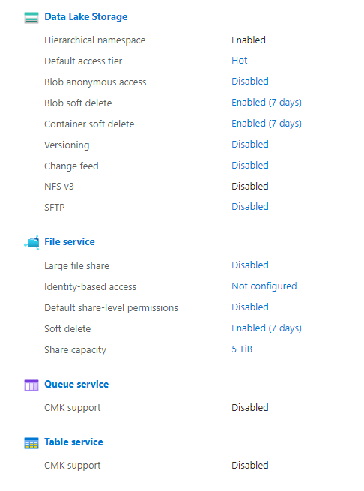
Azure Storage Data Services::
Azure Storage is a Microsoft-managed service providing cloud storage that is highly available, secure, durable, scalable, and redundant. Azure Storage includes Azure Blobs (objects), Azure Data Lake Storage Gen2, Azure Files, Azure Queues, and Azure Tables
With an Azure Storage account, you can choose from different types of storage services:
Azure Blob Storage (Azure Blobs)
Azure File Storage (Azure Files)
Azure Queue Storage (Azure Queues)
Azure Table Storage (Azure Tables)

Slide 14
CONTINUE…………..
Azure Blobs: A massively scalable object store for text and binary data. Also includes support for big data analytics through Data Lake Storage Gen2
Azure Blob Storage is basically a storage for unstructured data that can include pictures, videos, music files, documents, raw
data, and log data…along with their meta-data. Blobs are stored in a directory-like structure called a “container”. If you are familiar with AWS S3, containers work much the same way as S3 buckets. You can store any number of blob files up to a total size of 500 TB and, like S3, you can also apply security policies. Azure Blob Storage can also be used for data or device backup.
Azure Files: Managed file shares for cloud or on-premises deployments. Azure File Storage is meant for legacy applications. Azure VMs and services share their data via mounted file shares, while on-premise applications access the files using the File Service REST API. Azure File Storage offers file shares in the cloud using the standard SMB protocol and supports both SMB 3.0 and SMB 2.1.
Azure Queues: A messaging store for reliable messaging between application components. The Azure Queue Storage service is used to exchange messages between components either in the cloud or on-premise (compare to Amazon’s SQS). You can store large numbers of messages to be shared between independent components of applications and communicated asynchronously via HTTP or HTTPS.
Azure Table Storage, as the name indicates, is preferred for tabular data, which is ideal for key-value NoSQL data storage. Table Storage is massively scalable and extremely easy to use. Like other NoSQL data stores, it is schema-less and accessed via a REST API. Azure Table Storage is now part of Azure Cosmos DB.

Slide 15
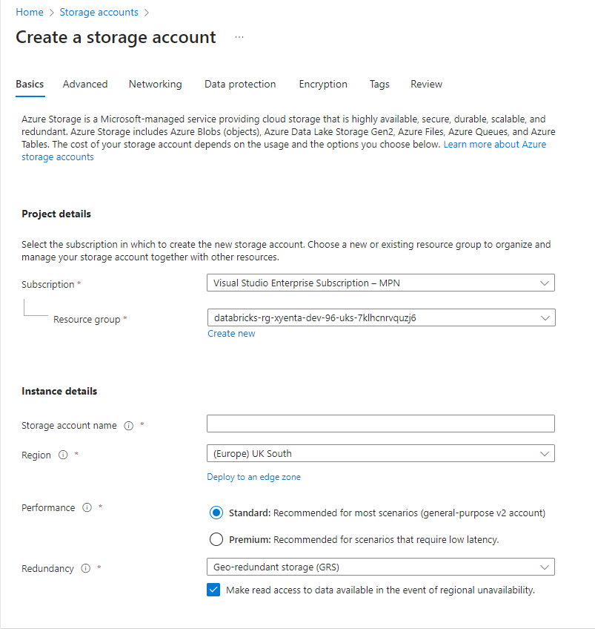
Azure Storage Account Creation ::
As we discussed earlier, To get the Services of Azure Storage, we need to create Storage account.Let’s discuss here how to storage account
Step 1: Visit Portal .com, click on create a resource and search for Storage Accounts
Step2 : Mention your subscription , resource group.
Setp3 : Define Storage account name and that should be unique across all existing storage accounts in Azure

Slide 16
Continue……
Step 4: Mention the region , so that our storage account will host in that region.
Step 5: In performance , select standard or premium , whenever you want to access the data with no delay or lower latency the choose premium
Step 6: Redundancy : Means that, the data in your Azure storage account is always replicated to ensure durability and high availability. Choose a replication strategy that matches your durability requirements. Some settings can't be changed after the storage account is created. Select any one of the following Local-redundant, Zone-redundant, Geo-redundant and Geo-zone-redundant (will cover more details in the next slide)
Step 7: In Advanced Tab , you can configure additional options and modify default settings for your new storage account. Some of these options can also be configured after the storage account is created, while others must be configured at the time of creation like selecting either you want Blob Storage or Gen2 or File Share
If you want a Gen2 Storage account, select Enable Hierarchical namespace, else if you want to create only Blob Storage go the Blob storage section at below
Link for Blob storage creation : https://k21academy.com/microsoft-azure/admin/azure-blob-storage/
Link for Gen2 Storage Creation : https://www.techbrothersit.com/2022/01/how-to-create-azure-data-lake-storage.html

Slide 17
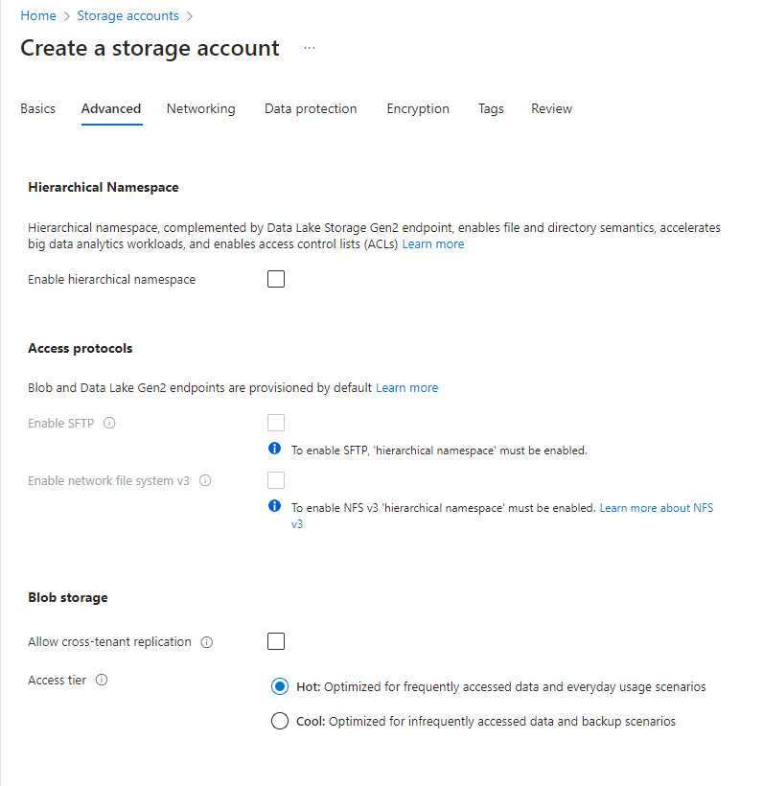
Continue….
Couple of options are left optional and they will manage by the Azure itself
Access Tier tells you about either you want to access file or blob from Blob Storage account frequently or not
Once after mentioning necessary details click on Review
If review successful, then click on create button
The files or data presented in the storage account
Can be accessed using Access Key
Useful link : https://learn.microsoft.com/en-us/azure/storage/common/storage-account-create?tabs=azure-portal

Slide 18
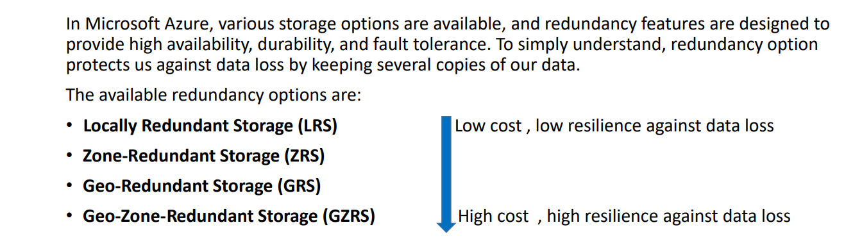
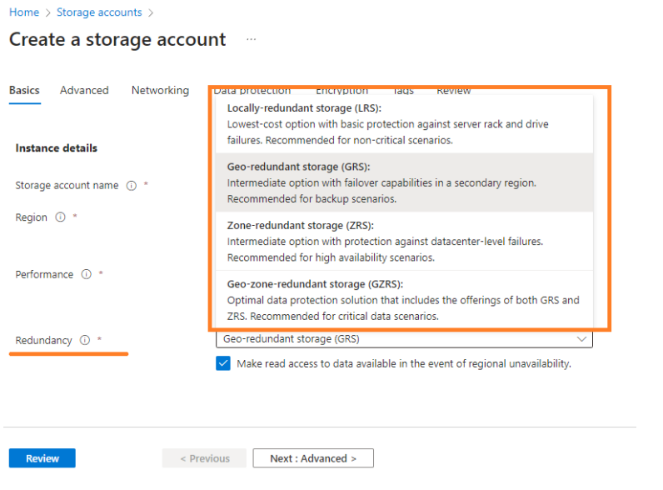
::Azure Storage Account Redundancy ::

Slide 19
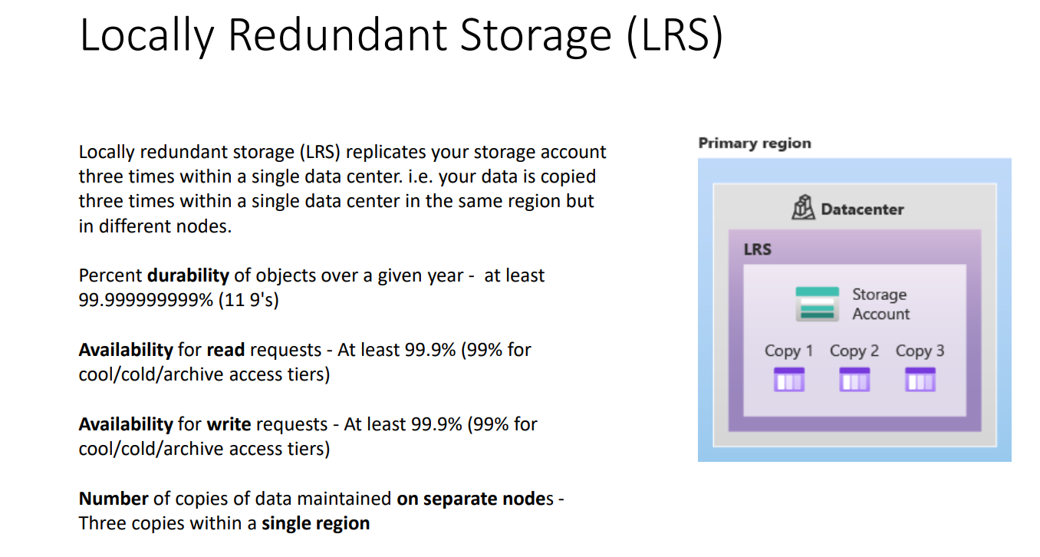

Slide 20
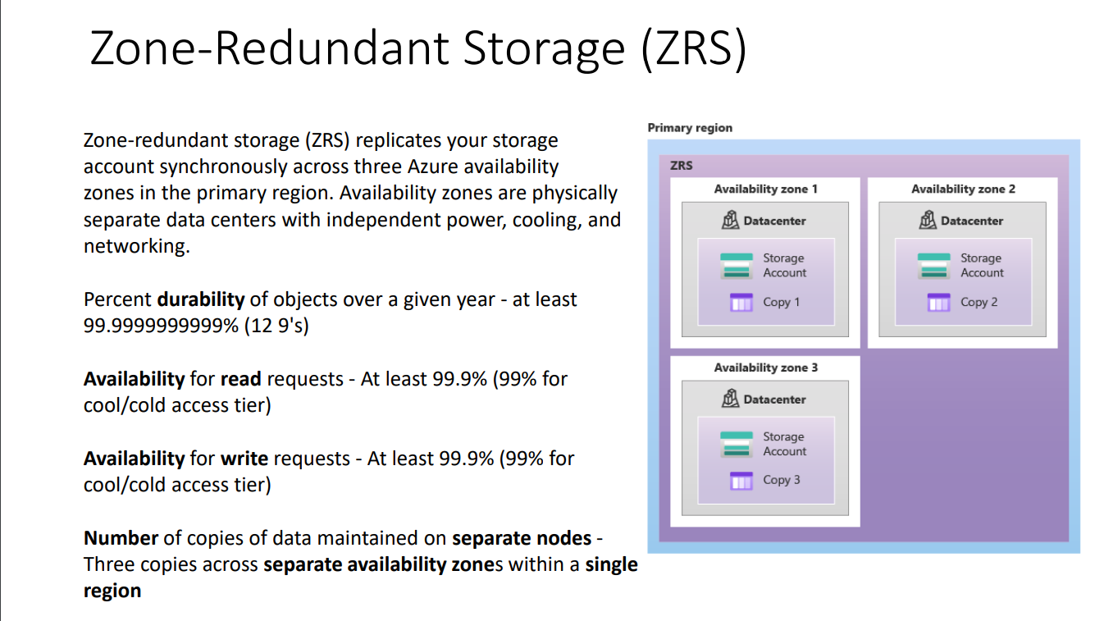

Slide 21
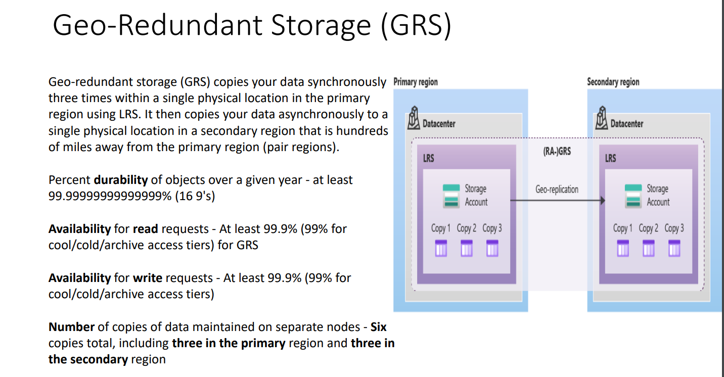

Slide 22
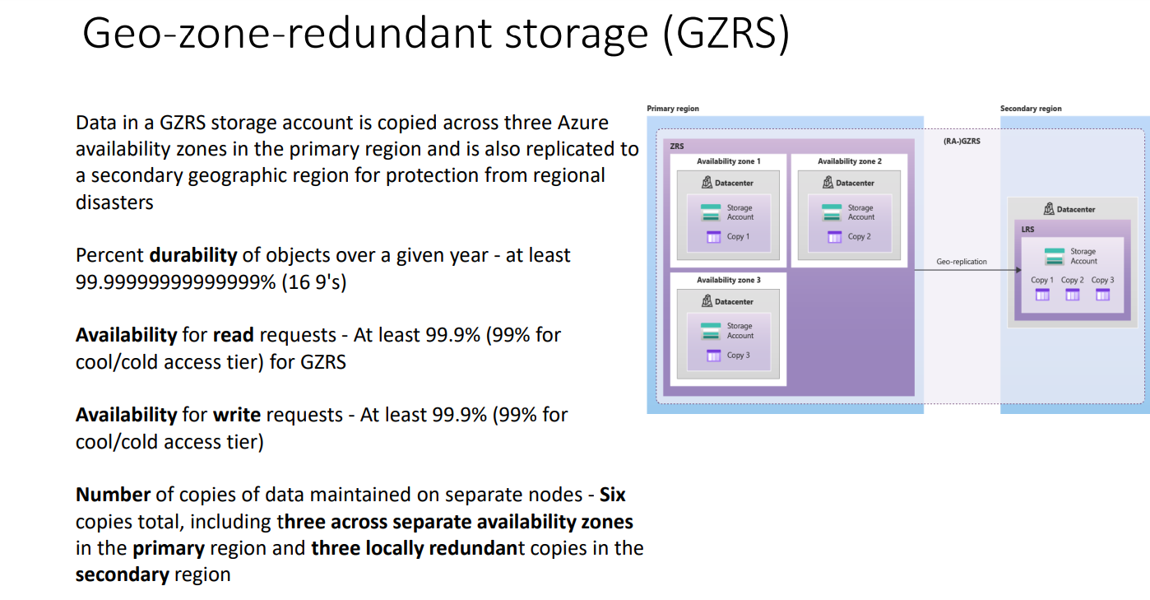

Slide 23
::Azure SQL::
Azure SQL is Microsoft’s cloud database service(PAAS). Based on SQL Server database technology and built on Microsoft’s Windows Azure cloud computing platform, SQL Azure enables organizations to store relational data in the cloud and quickly scale the size of their databases up or down as business needs change. Data is hosted, managed and provisioned in Microsoft data centers.
Organizations can build applications on-premises and move them to SQL Azure or build them on Windows Azure and keep the data in the cloud. SQL Azure supports SQL Server’s Transact-SQL (T-SQL) query language, offers built-in support for high availability and fault tolerance and allows for data to be synchronized between on-premises SQL Server and cloud databases.
If you want to create a database, you can create a database on-premise that will leave you to maintain the operating system and database server. Further, in the case of an on-premise database, disaster recovery and High Availability will become your headache.
Apart from the above features in the cloud, what about the upgrade to facilitate future scalability. Sometimes, you will have adhoc data loads that need additional resources for a short duration of time. Your on-premises database will not be able to support short time resources that can be supported by the Azure SQL Database.

Slide 24
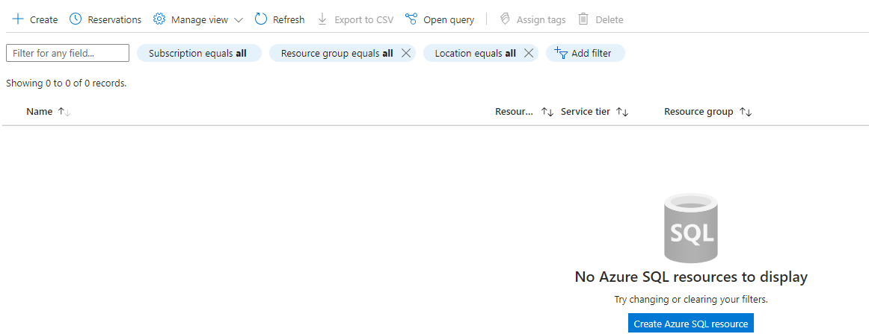
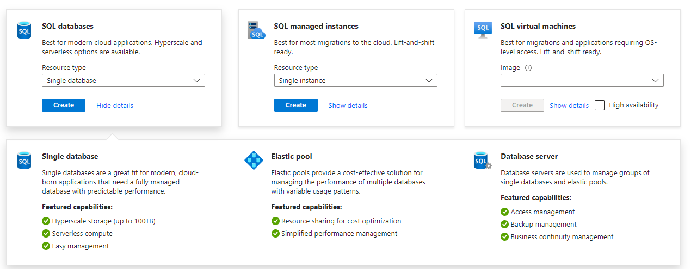
Continue…
Step 1: Go to Azure portal and search for Azure SQL
Step 2: The landing page

Slide 25
Continue….
Let’s talk about single database, Elastic pool, Data server in SQL Databases which you seen in the previous slide.
Single Database: It just like a regular databases like Adventures work etc., we will use this when our application requires single database
Elastic Pool : Elastic pools provide a simple and cost-effective solution for managing the performance of multiple databases within a fixed budget
Database Server: You can’t create a Database that may be a single or even an elastic pool with out servers. You pay only for databases/elastic pools, but you manage them through database server. One server can host many databases. Database Server is free and is mostly a logical/management tool, something like a "Resource Group“
Useful link : https://learn.microsoft.com/en-us/azure/azure-sql/database/single-database-create-quickstart?view=azuresql&tabs=azure-portal
https://www.c-sharpcorner.com/article/how-to-create-azure-sql-database-using-azure-portal/

Slide 26
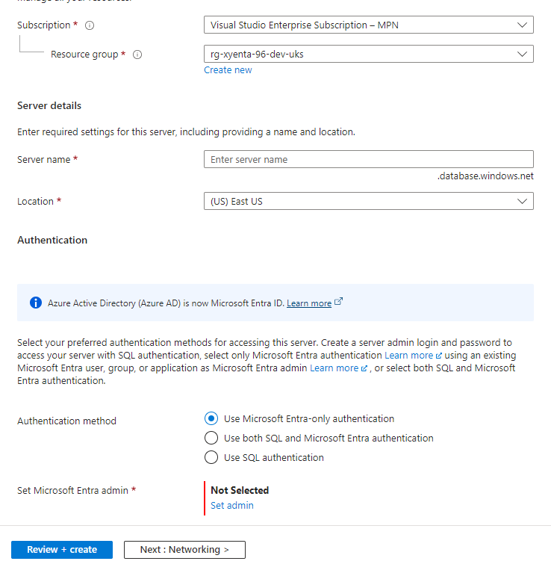
Continue…
Create a database server: Mention the server name
And location as well. In addition to that select the
Authentication method like Use SQL Authentication

Slide 27
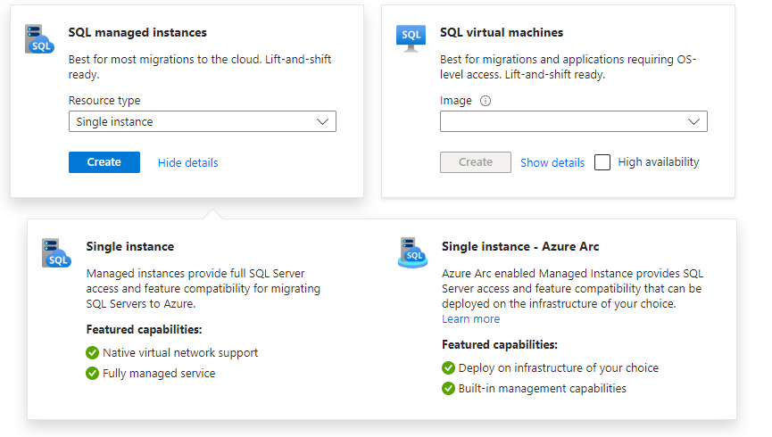
Continue..
Now, lets talk about SQL Managed Instances : Azure SQL Managed Instance is a fully managed database service that provides nearly 100% compatibility with the latest SQL Server (Enterprise Edition) database engine. It combines the benefits of both PaaS and traditional SQL Servers, offering a seamless migration path for applications dependent on SQL Server features. With SQL Managed Instance, you can take advantage of high-performance computing and comprehensive database capabilities while reducing administrative overhead. Considering resource limits when opting for this option is crucial to ensure optimal performance.
It’s a server less
Useful link : https://www.mssqltips.com/sqlservertip/7467/azure-sql-managed-instance-deploy-configure-test/

Slide 28
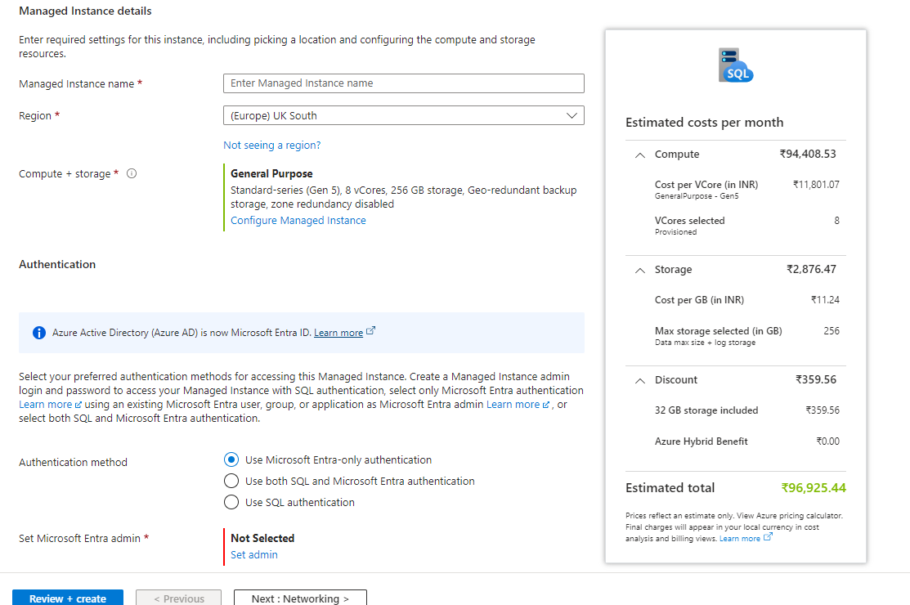
Continue…..
Click on Single Instance then we will land up into this

Slide 29
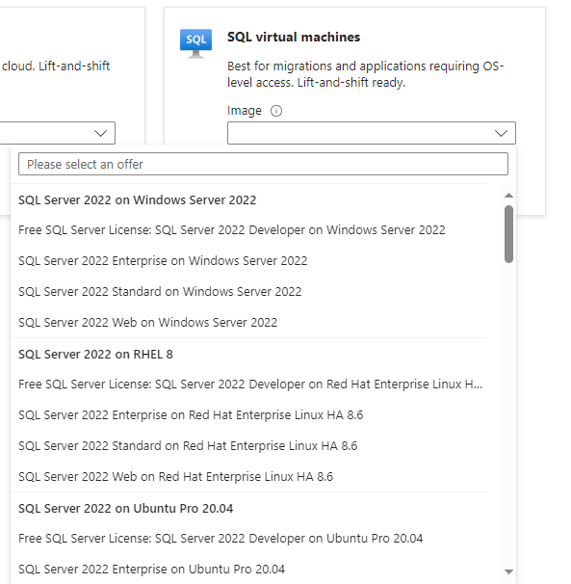
Continue……
Azure SQL with VM’s is an IaaS, we need to
Pick an image to deploy a single SQL virtual machine when high availability checkbox is unselected. Or pick an image to deploy multiple SQL virtual machines within a high availability group when high availability checkbox is selected.
Useful link : https://learn.microsoft.com/en-us/azure/azure-sql/virtual-machines/windows/sql-vm-create-portal-quickstart?view=azuresql&tabs=conventional-vm
https://www.sqlshack.com/deploy-sql-server-on-azure-vm-using-the-azure-portal/

Slide 30
::Azure Key Vaults::
Azure Key Vault is a cloud service for securely storing and accessing secrets. A secret is anything that you want to tightly control access to, such as API keys, passwords. With Azure Key Vault, you can store and manage your most sensitive information in a secure and compliant manner.
Azure Key vaults consists of 3 objects as Keys, Secrets, Certificates. But most important one is the secrets
Secrets: Say, your web application needs to connect to an external API that requires an API key for authentication. You would store this API key as a secret in Azure Key Vault, allowing your application to securely retrieve it when making API requests. whenever the vendor changes the key, you can update it in Secrets.

Slide 31
::Data Bricks::
Databricks is a cloud-based platform for managing and analyzing large datasets using the Apache Spark open-source big data processing engine. It offers a unified workspace for data scientists, engineers, and business analysts to collaborate, develop, and deploy data-driven applications.
Databricks is designed to make working with big data easier and more efficient, by providing tools and services for data preparation, real-time analysis, and machine learning. Some key features of Databricks include support for various data formats, integration with popular data science libraries and frameworks, and the ability to scale up and down as needed.
It is commonly used for tasks such as data preparation, real-time analysis, and machine learning using pyspark / R/ Scala etc.,
Its also called as Lakehouse platform (DWH + Data Lake)
To create a DataBricks workspace > Go to Portal.com > Search for DataBricks > click on create DataBricks
Useful link : https://learn.microsoft.com/en-us/azure/databricks/getting-started/

Slide 32
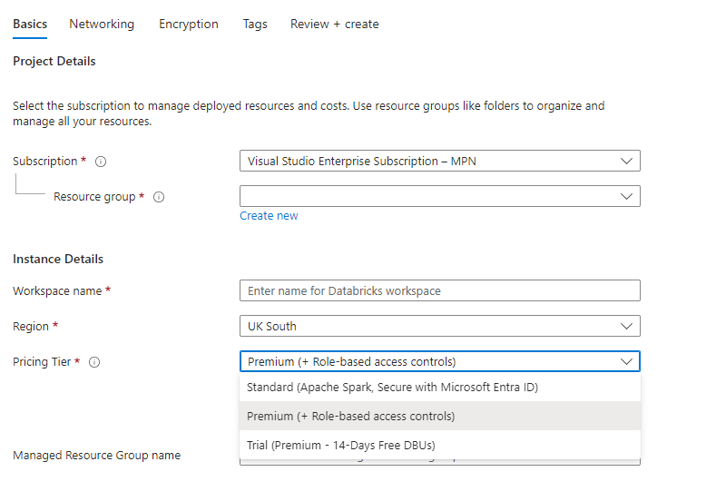
Continue…..
Mention the Resource Group Name, workspace name, region and select pricing Tier
In standard , there is no access control, and every user are admin
and any user can add another user even that
does not have access or any resource group or subscription.
In Pricing tier and it’s the most recommended one as well,
Where we can have role-based controls .
The Basic price for standard starts from $0.15DBU
And for the premium from $0.20DBU
Every Databricks workspace has a resource group
managed by it
and contains the resources that the workspace needs
Useful link : https://medium.com/cloudsafari-ca/azure-databricks-deployments-issues-30577c78c911

Slide 33
:: Important Terminology in DataBricks::
Cluster : Its an engine used to run our code as fast as possible to get the descried output on DataBricks . Cluster consists of group of Nodes (CPU’s). This cluster is used to distribute the data and do the processing
At a faster rate .
Notebook : It’s just like a file, where we will write our code to process the data. This Notebook uses the cluster for the execution
Workspace: a web-based interface for organizing and collaborating on Databricks projects.
Jobs: a way to automate notebook or Python code execution on a schedule or on a trigger (e.g., the arrival of new data).
Libraries: pre-packaged code that can be imported into notebooks or jobs to perform common tasks (e.g., reading from a database or performing machine learning).
Autoscaling: a feature that allows Databricks clusters to automatically scale up or down based on workload demands.

